Slide 1
SOFTWARE REQUIREMENT SPECIFICATION

Slide 2
LEARNING OBJECTIVES
  UNDERSTAND THE IMPORTANCE AND USE OF SOFTWARE REQUIREMENTS SPECIFICATION REPORT IN SOFTWARE DEVELOPMENT
  LEARN THE DIFFERENT FEATURES AND PROPERTIES OF A GOOD SRS DOCUMENT
  CONSTRUCT A SOFTWARE REQUIREMENTS SPECIFICATION REPORT

Slide 3
WHAT IS SRS
The production of the requirements stage of the software development process is Software Requirements Specifications (SRS) (also called a requirements document).
The SRS is a specification for a specific software product, program, or set of applications that perform particular functions in a specific environment.

Slide 4
CONTENTS/PARTS OF SRS
  Introduction.
  Functional data description.
  Subsystem description.
  System modeling and simulation results.
  Products.
  Appendices.

Slide 5
TYPES OF REQUIREMENTS
  Functional requirements:
  Non-functional requirements:

Slide 6
FUNCTIONAL REQUIREMENTS
  input/output
  Processing.
  Error handling.

Slide 7
NON-FUNCTIONAL
  Physical environment (equipment locations, multiple sites, etc.).ber
  Interfaces (data medium etc.).
  User & human factors (who are the users, their skill level etc.).
  Performance (how well is system functioning).
  Documentation.
  Data (qualitative stuff).
  Resources (finding, physical space).
  Security (backup, firewall).
  Quality assurance (max. down time, MTBF, etc.).

Slide 8
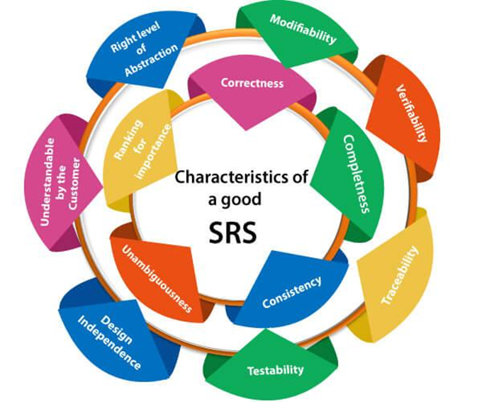
CHARACTERISTICS OF GOOD SRS

Slide 9
CHARACTERISTICS
Correctness: User review is used to provide the accuracy of requirements stated in the SRS. SRS is said to be perfect if it covers all the needs that are truly expected from the system.

Slide 10
CHARACTERISTICS
Completeness: The SRS is complete if, and only if, it includes the following elements:
(1). All essential requirements, whether relating to functionality, performance, design, constraints, attributes, or external interfaces.
(2). Definition of their responses of the software to all realizable classes of input data in all available categories of situations.
(3). Full labels and references to all figures, tables, and diagrams in the SRS and definitions of all terms and units of measure.

Slide 11
CHARACTERISTICS
Consistency: The SRS is consistent if, and only if, no subset of individual requirements described in its conflict.

Slide 12
CHARACTERISTICS
Unambiguousness: SRS is unambiguous when every fixed requirement has only one interpretation. This suggests that each element is uniquely interpreted. In case there is a method used with multiple definitions, the requirements report should determine the implications in the SRS so that it is clear and simple to understand.

Slide 13
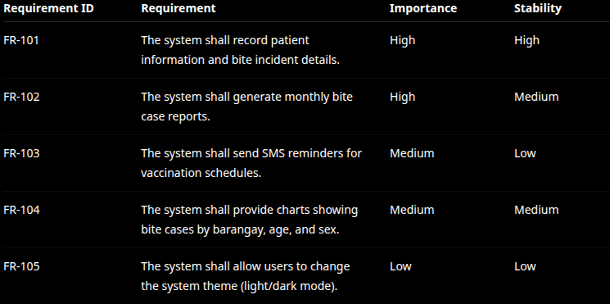
CHARACTERISTICS
Ranking for importance and stability: The SRS is ranked for importance and stability if each requirement in it has an identifier to indicate either the significance or stability of that particular requirement.

Slide 14
CHARACTERISTICS
Modifiability: SRS should be made as modifiable as likely and should be capable of quickly obtain changes to the system to some extent. Modifications should be perfectly indexed and cross-referenced.

Slide 15
CHARACTERISTICS
Verifiability: SRS is correct when the specified requirements can be verified with a cost-effective system to check whether the final software meets those requirements. The requirements are verified with the help of reviews.

Slide 16
CHARACTERISTICS
Traceability: The SRS is traceable if the origin of each of the requirements is clear and if it facilitates the referencing of each condition in future development or enhancement documentation.
  1. Backward Traceability: This depends upon each requirement explicitly referencing its source in earlier documents.
  2. Forward Traceability: This depends upon each element in the SRS having a unique name or reference number.

Slide 17
CHARACTERISTICS
Design Independence: There should be an option to select from multiple design alternatives for the final system. More specifically, the SRS should not contain any implementation details.

Slide 18
CHARACTERISTICS
Testability: An SRS should be written in such a method that it is simple to generate test cases and test plans from the report.

Slide 19
CHARACTERISTICS
Understandable by the customer: An end user may be an expert in his/her explicit domain but might not be trained in computer science. Hence, the purpose of formal notations and symbols should be avoided too as much extent as possible. The language should be kept simple and clear.

Slide 20
CHARACTERISTICS
The right level of abstraction: If the SRS is written for the requirements stage, the details should be explained explicitly. Whereas,for a feasibility study, fewer analysis can be used. Hence, the level of abstraction modifies according to the objective of the SRS.

Slide 21
REQUIREMENT ANALYSIS

Slide 22
ANALYSIS OBJECTIVES
●Identify customer’s needs.
●Evaluate system for feasibility.
●Perform economic and technical analysis.
●Allocate functions to system elements.
●Establish schedule and constraints.
●Create system definitions.

Slide 23
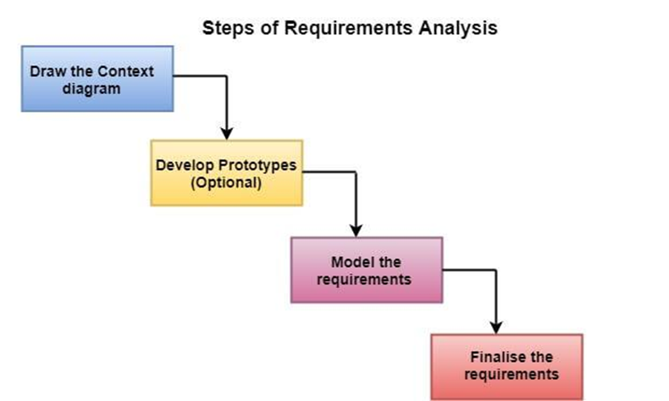

Slide 24
STEPS IN REQUIREMENT ANALYSIS
Draw the context diagram: The context diagram is a simple model that defines the boundaries and interfaces of the proposed systems with the external world. It identifies the entities outside the proposed system that interact with the system.

Slide 25
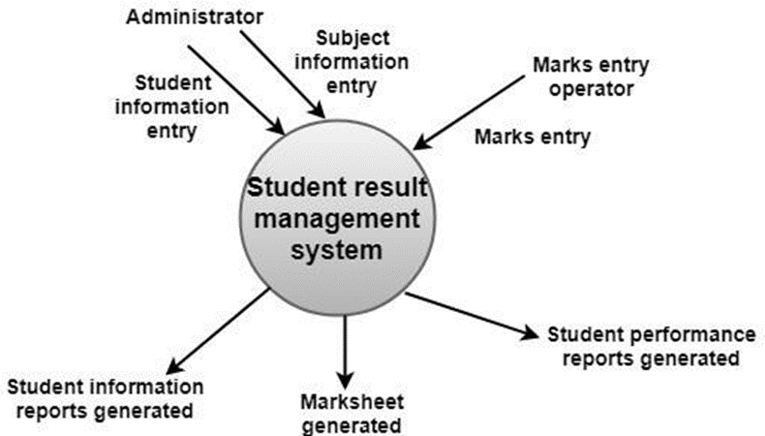

Slide 26
STEPS IN REQUIREMENT ANALYSIS
Development of a Prototype: One effective way to find out what the customer wants is to construct a prototype, something that looks and preferably acts as part of the system they say they want.

Slide 27
TYPES OF PROTOTYPING
Throwaway Prototyping
  prototype only used as a demonstration of product requirements
  finished software is engineered using another paradigm
Evolutionary Rapid Prototyping

Slide 28
STEPS IN REQUIREMENT ANALYSIS
Model the requirements: This process usually consists of various graphical representations of the functions, data entities, external entities, and the relationships between them. The graphical view may help to find incorrect, inconsistent, missing, and superfluous requirements. Such models include the Data Flow diagram, Entity-Relationship diagram, Data Dictionaries, State-transition diagrams, etc.

Slide 29
TYPES OF MODEL
a) Data model - shows relationships among system objects
b) Functional model - description of the functions that enable the transformations of system objects
c) Behavioral model - manner in which software responds to events from the outside world

Slide 30
STEPS IN REQUIREMENT ANALYSIS
Finalise the requirements: After modeling the requirements, we will have a better understanding of the system behavior. The inconsistencies and ambiguities have been identified and corrected. The flow of data amongst various modules has been analyzed. Elicitation and analyze activities have provided better insight into the system. Now we finalize the analyzed requirements, and the next step is to document these requirements in a prescribed format.

Slide 31
REQUIREMENT ANALYSIS AND MODELING

Slide 32
LEARNING OBJECTIVES
  UNDERSTAND THE PURPOSE OF ERD
  KNOW THE DIFFERENT COMPONENTS OF ERD
  LEARN HOW TO CREATE AN ERD

Slide 33
WHAT IS ERD
ER-modeling is a data modeling method used in software engineering to produce a conceptual data model of an information system.

Slide 34
PURPOSE OF ERD
  The database analyst gains a better understanding of the data to be contained in the database through the step of constructing the ERD.
  The ERD serves as a documentation tool.
  Finally, the ERD is used to connect the logical structure of the database to users. In particular, the ERD effectively communicates the logic of the database to users.

Slide 35
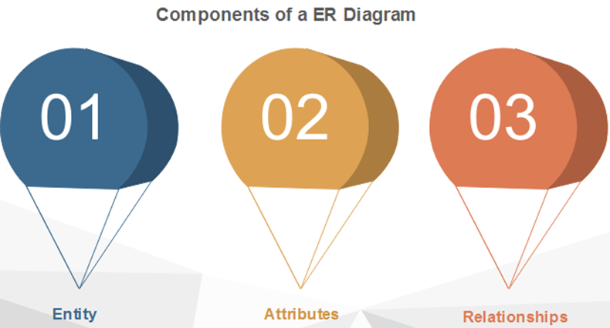

Slide 36
ENTITY
An entity can be a real-world object, either animate or inanimate, that can be merely identifiable. An entity is denoted as a rectangle in an ER diagram. For example, in a school database, students, teachers, classes, and courses offered can be treated as entities. All these entities have some attributes or properties that give them their identity.

Slide 37
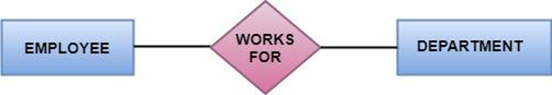
ENTITY SET
An entity set is a collection of related types of entities. An entity set may include entities with attribute sharing similar values. For example, a Student set may contain all the students of a school; likewise, a Teacher set may include all the teachers of a school from all faculties. Entity set need not be disjoint.

Slide 38
ATTRIBUTES
Entities are denoted utilizing their properties, known as attributes. All attributes have values. For example, a student entity may have name, class, and age as attributes. There exists a domain or range of values that can be assigned to attributes. For example, a student's name cannot be a numeric value. It has to be alphabetic. A student's age cannot be negative, etc.

Slide 39
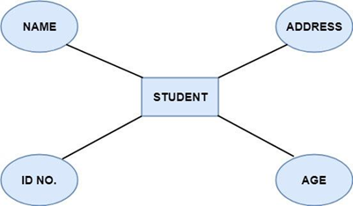

Slide 40
TYPES OF ATTRIBUTES
Key attribute - Key is an attribute or collection of attributes that uniquely identifies an entity among the entity set. For example, the roll_number of a student makes him identifiable among students.

Slide 41
TYPES OF KEYS
⮚Super key: A set of attributes that collectively identifies an entity in the entity set.
⮚Candidate key: A minimal super key is known as a candidate key. An entity set may have more than one candidate key.
⮚Primary key: A primary key is one of the candidate keys chosen by the database designer to uniquely identify the entity set.

Slide 42
TYPES OF ATTRIBUTES
❖Composite attribute - An attribute that is a combination of other attributes is called a composite attribute. For example, In student entity, the student address is a composite attribute as an address is composed of other characteristics such as pin code, state, country.

Slide 43
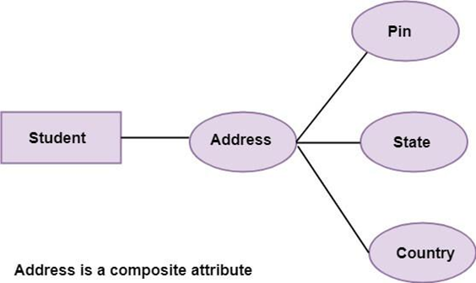

Slide 44
TYPES OF ATTRIBUTES
Single-valued attribute - Single-valued attribute contain a single value. For example, Social_Security_Number.

Slide 45
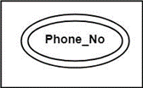
TYPES OF ATTRIBUTES
Multi-valued attribute - If an attribute can have more than one value, it is known as a multi-valued attribute. Multi-valued attributes are depicted by the double ellipse. For example, a person can have more than one phone number, email-address,

Slide 46
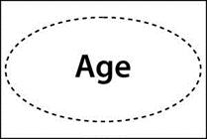
TYPES OF ATTRIBUTES
❖ Derived attribute - Derived attributes are the attribute that does not exist in the physical database, but their values are derived from other attributes present in the database. For example, age can be derived from date_of_birth. In the ER diagram, Derived attributes are depicted by the dashed ellipse.

Slide 47
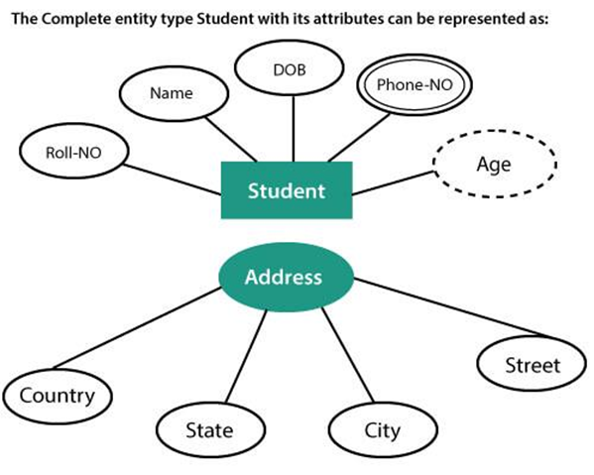

Slide 48
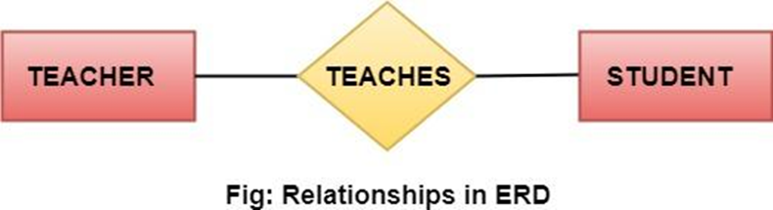
RELATIONSHIP
The association among entities is known as relationship. Relationships are represented by the diamond-shaped box. For example, an employee works_at a department, a student enrolls in a course. Here, Works_at and Enrolls are called relationships.

Slide 49
RELATIONSHIP SET
A set of relationships of a similar type is known as a relationship set. Like entities, a relationship too can have attributes. These attributes are called descriptive attributes.

Slide 50
DEGREE OF A RELATIONSHIP SET
The number of participating entities in a relationship describes the degree of the relationship. The three most common relationships in E-R models are:

Slide 51
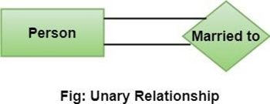
UNARY (DEGREE1)
This is also called recursive relationships. It is a relationship between the instances of one entity type. For example, one person is married to only one person.

Slide 52
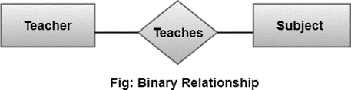
BINARY (DEGREE2)
It is a relationship between the instances of two entity types. For example, the Teacher teaches the subject.

Slide 53
TERNARY (DEGREE3)
It is a relationship amongst instances of three entity types. In fig, the relationships "may have" provide the association of three entities, i.e., TEACHER, STUDENT, and SUBJECT. All three entities are many-to-many participants. There may be one or many participants in a ternary relationship.

Slide 54
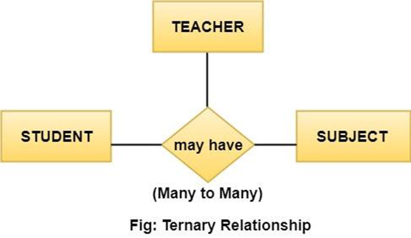

Slide 55
CARDINALITY
Cardinality describes the number of entities in one entity set, which can be associated with the number of entities of other sets via relationship set.

Slide 56
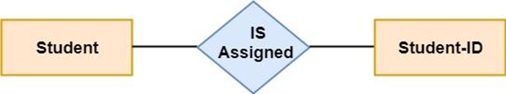
TYPES OF CARDINALITIES
One to One: One entity from entity set A can be contained with at most one entity of entity set B and vice versa. Let us assume that each student has only one student ID, and each student ID is assigned to only one person. So, the relationship will be one to one.

Slide 57
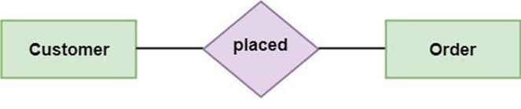
TYPES OF CARDINALITIES
One to many: When a single instance of an entity is associated with more than one instances of another entity then it is called one to many relationships. For example, a client can place many orders; a order cannot be placed by many customers.

Slide 58
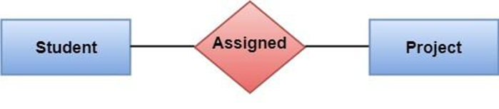
TYPES OF CARDINALITIES
Many to Many: One entity from A can be associated with more than one entity from B and vice-versa. For example, the student can be assigned to many projects, and a project can be assigned to many students.

Slide 59
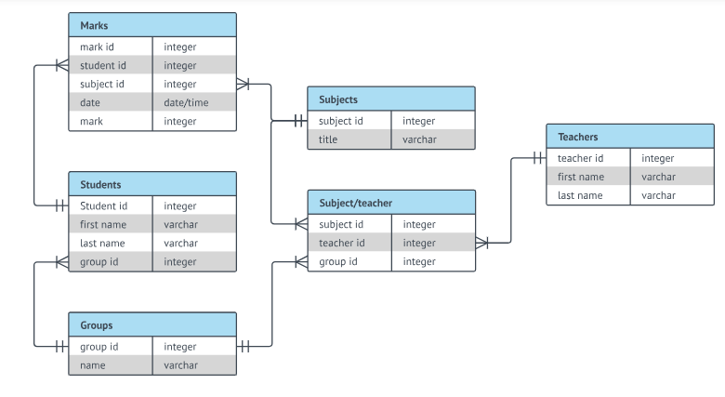

Slide 60
DATA FLOW DIAGRAM

Slide 61
LEARNING OBJECTIVES
  Understand the use of data flow diagram
  Know the different symbols used in dfd
  Understand the levels of data flow diagraM
  Learn the different data flow diagram errORS
  Learn the different dfd diagramming rules

Slide 62
WHAT IS DATA FLOW DIAGRAM
A Data Flow Diagram (DFD) is a traditional visual representation of the information flows within a system. A neat and clear DFD can depict the right amount of the system requirement graphically. It can be manual, automated, or a combination of both.

Slide 63
ESSENTIAL FOR DFD
1)All names should be unique. This makes it easier to refer to elements in the DFD.
2)Remember that DFD is not a flow chart. Arrows in a flow chart that represents the order of events; arrows in DFD represents flowing data. A DFD does not involve any order of events.

Slide 64
ESSENTIAL FOR DFD
3) Suppress logical decisions. If we ever have the urge to draw a diamond-shaped box in a DFD, suppress that urge! A diamond-shaped box is used in flow charts to represents decision points with multiple exists paths of which the only one is taken. This implies an ordering of events, which makes no sense in a DFD.
4) Do not become bogged down with details. Defer error conditions and error handling until the end of the analysis.

Slide 65
0-LEVEL DFD
The Level-0 DFD, also called context diagram of the result management system is shown in fig. As the bubbles are decomposed into less and less abstract bubbles, the corresponding data flow may also be needed to be decomposed.

Slide 66
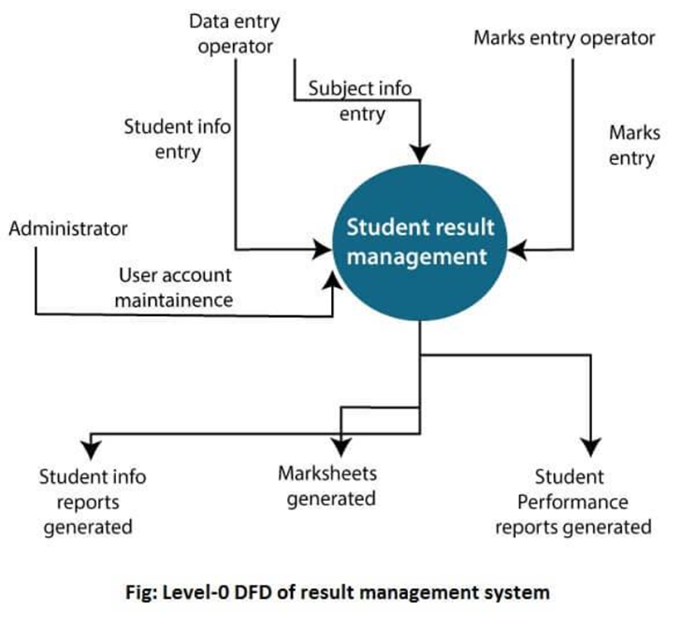
0-LEVEL DFD

Slide 67
1-LEVEL DFD
In 1-level DFD, a context diagram is decomposed into multiple bubbles/processes. In this level, we highlight the main objectives of the system and breakdown the high-level process of 0-level DFD into subprocesses.

Slide 68
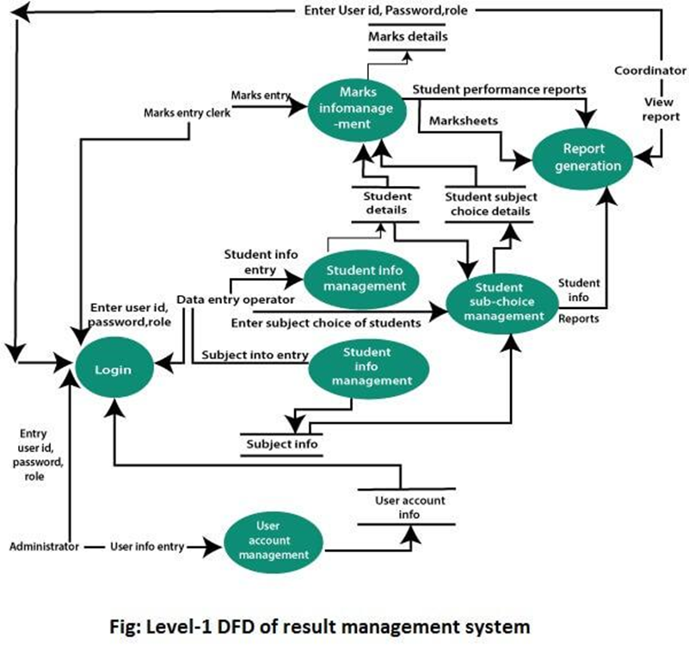
1-LEVEL DFD

Slide 69
2-LEVEL DFD
2-level DFD goes one process deeper into parts of 1-level DFD. It can be used to project or record the specific/necessary detail about the system's functioning.

Slide 70
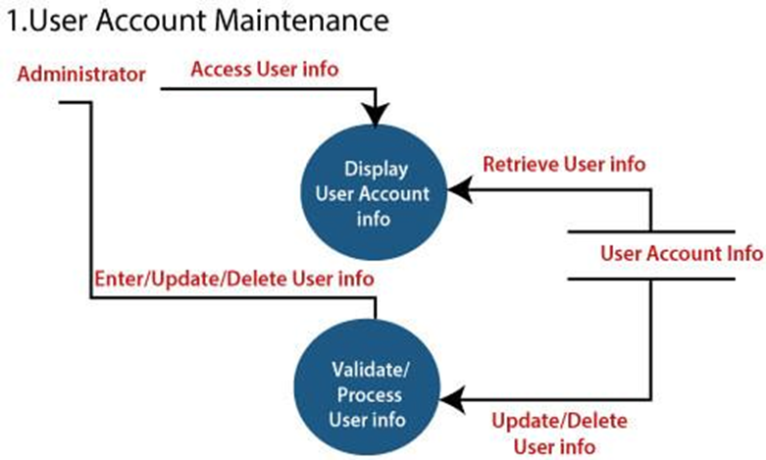
2-LEVEL DFD

Slide 71
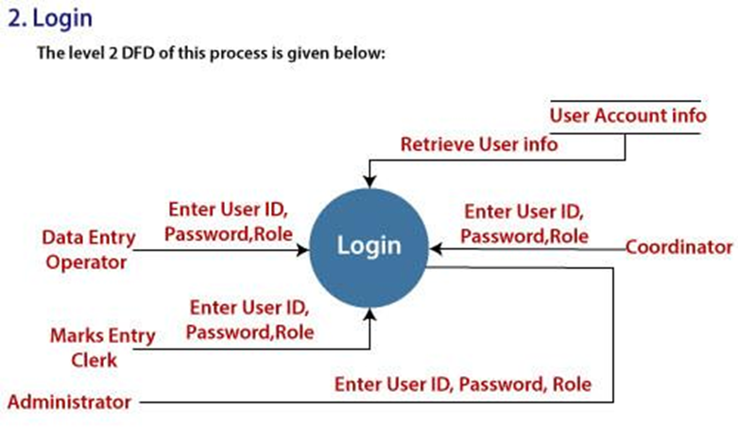
2-LEVEL DFD

Slide 72
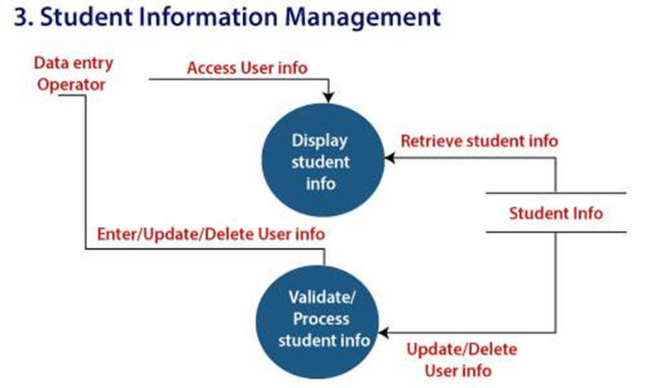
2-LEVEL DFD

Slide 73
2-LEVEL DFD

Slide 74
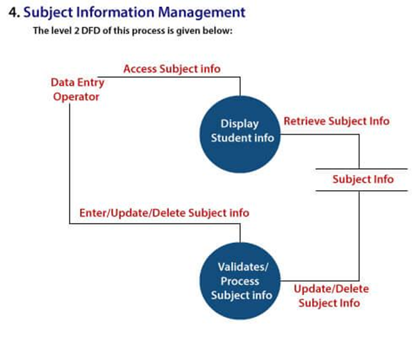
2-LEVEL DFD

Slide 75
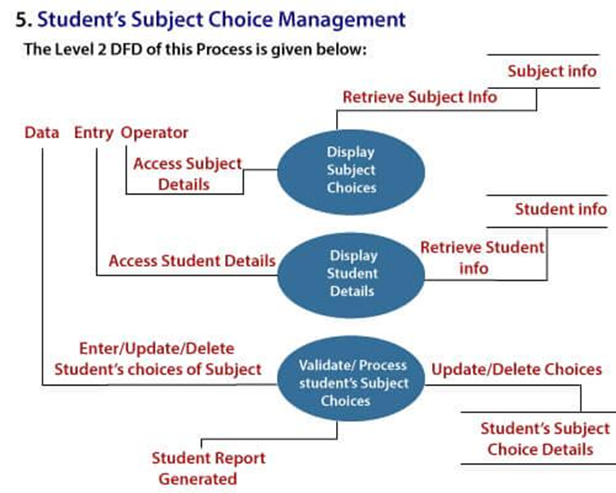
2-LEVEL DFD

Slide 76
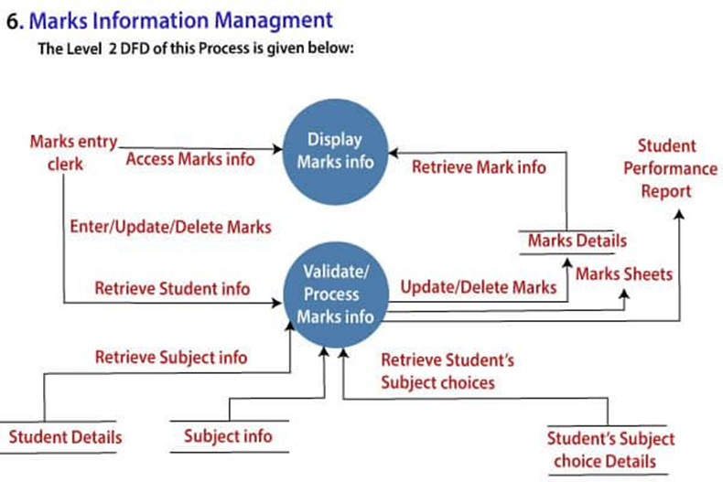
2-LEVEL DFD

Slide 77
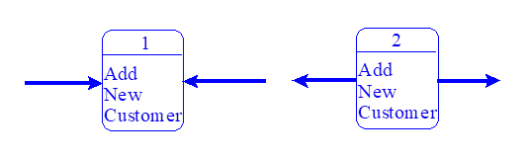
DATA FLOW DIAGRAM ERRORS
1) A process with only input data flow or only output data flow from it.

Slide 78
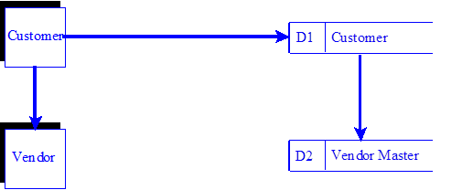
DATA FLOW DIAGRAM ERRORS
1) Data stores or external entities are connected directly to each other, in any combination.

Slide 79
DATA FLOW DIAGRAM ERRORS
3) Incorrectly labeling data flow or objects
Examples are:
  a)Labels omitted from data flow or objects.
  b)Data flow labeled with a verb.
  c)Processes labeled with a noun.
4)Too many processes on a data flow diagram.
  a)Nine is the suggested maximum.

Slide 80
DATA FLOW DIAGRAM ERRORS
1)Omitting data flow from the diagram
2)Unbalanced decomposition between a parent process and a child diagram
  a) The data flow in and out of a parent process must be present on the child diagram.

Slide 81
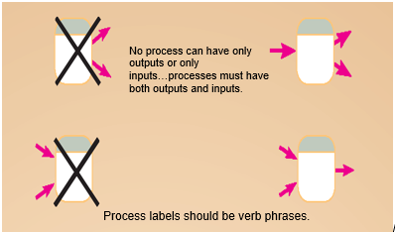
DFD DIAGRAMMING RULES
PROCESS

Slide 82
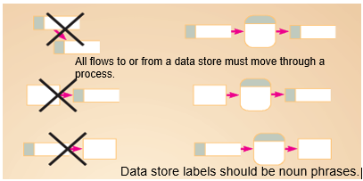
DFD DIAGRAMMING RULES
DATA STORE

Slide 83
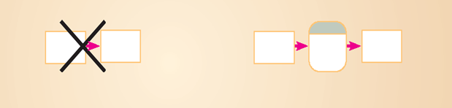
DFD DIAGRAMMING RULES
SOURCE/SINK
No data moves directly between external entities without going through a process.
Interactions between external entities without intervening processes are outside the system and therefore not represented in the DFD.

Slide 84
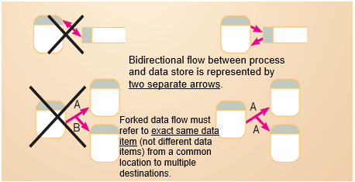
DFD DIAGRAMMING RULES
DATA FLOW

Slide 85
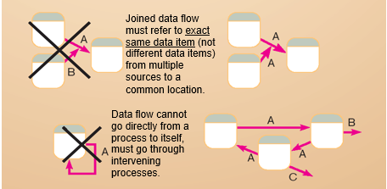
DFD DIAGRAMMING RULES
DATA FLOW

Slide 86
THANK
YOU

